Slide 1
Introduction to Vision-Language Pre-training and BLIP
Presenter: Yupan Huang
Date: 02/11/2022

Slide 2
Outline
Background of Vision-Language Pre-training (VLP)
Datasets
Model Architectures
Pre-training Objectives
Visual Features
Representative VLP Models
Introduction to the BLIP: Bootstrapping Language-Image Pre-training for Unified Vision-Language Understanding and Generation
Method
Experiments
Discussion

Slide 3
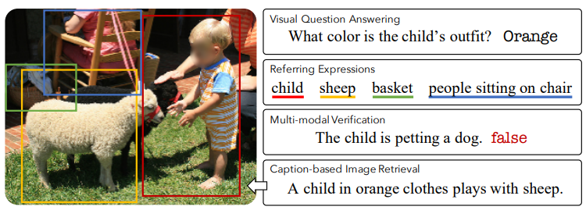
Vision-Language Research
Train an AI system that can see/paint (Vision) and talk (Language).
Common tasks:
Image credit: Lu, Jiasen, et al. "12-in-1: Multi-task vision and language representation learning." CVPR. 2020.
Notes:
Much of vision-and-language research focuses on a small but diverse set of independent tasks and supporting datasets often studied in isolation; however, the visually grounded language understanding skills required for success at these tasks overlap significantly.

Slide 4
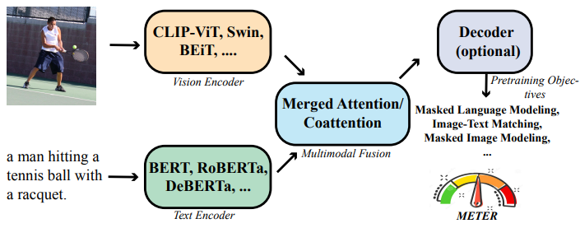
Vision-Language Pre-training (VLP)
Image credit: Dou, Zi-Yi, et al. "An Empirical Study of Training End-to-End Vision-and-Language Transformers." arXiv preprint arXiv:2111.02387 (2021).

Slide 5
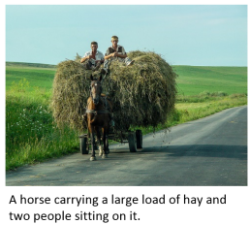
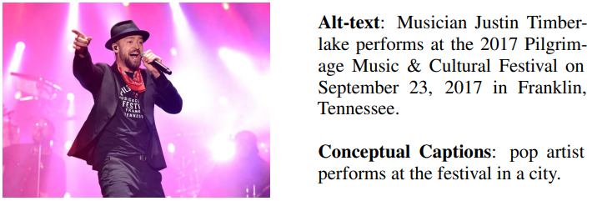
Vision-Language Datasets (Image-Text Pairs)
 | Human-annotated Datasets |  | Noisy Web Datasets
 | COCO | Visual Genome | SBU captions | Conceptual Captions | Conceptual 12M | LAION | ALIGN (in house)
#Image | 113K | 100K | 860K | 3M | 10M | 400M | 1.8B
#Text | 567K | 769K | 860K | 3M | 10M | 400M | 1.8B
Left image: Chen, Xinlei, et al. "Microsoft coco captions: Data collection and evaluation server." arXiv preprint arXiv:1504.00325 (2015).
Right image: Sharma, Piyush, et al. "Conceptual captions: A cleaned, hypernymed, image alt-text dataset for automatic image captioning." ACL 2018.
Notes:
large-scale easy-accessible image-text pairs

Slide 6
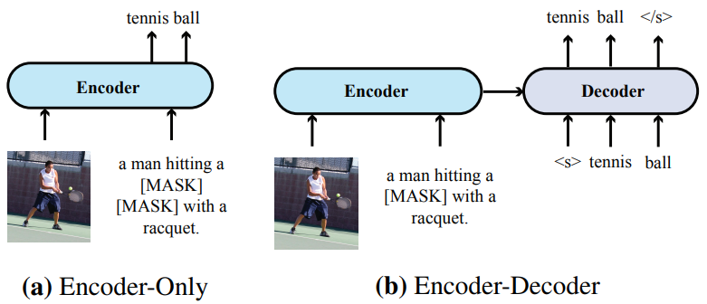
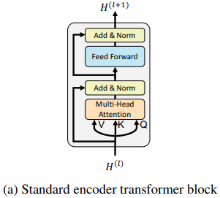
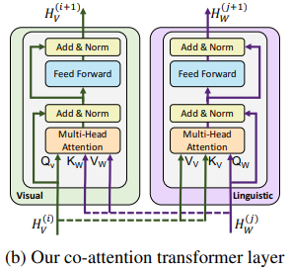
Model Architectures
Encoder-only
Encoder-decoder
Single-stream
Two-stream
Left image: Dou, Zi-Yi, et al. "An Empirical Study of Training End-to-End Vision-and-Language Transformers." arXiv preprint arXiv:2111.02387 (2021).
Right image: Lu, Jiasen, et al. "Vilbert: Pretraining task-agnostic visiolinguistic representations for vision-and-language tasks." in NeurIPS 2019).

Slide 7
Pre-training Objectives for VLP
(M)LM: (masked) language modeling
(M)IM: (masked) image modeling
ITC: image-text contrastive learning
Align the feature space of the visual transformer and the text transformer
Encourage positive image-text pairs to have similar representations in contrast to the negative pairs.
ITM: image-text matching
Fine-grained VL alignment
Whether an image-text pair is positive (matched) or negative (unmatched)
WRA: word-region alignment

Slide 8
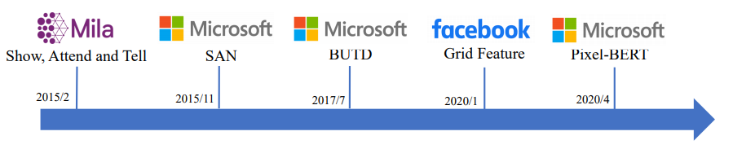
Visual Features in VL Models
ViLT
2021/2
Grid
Region
Grid
No CNN
Specific vision-language tasks
Pre-training
Image credict: https://rohit497.github.io/Recent-Advances-in-Vision-and-Language-Research/slides/tutorial-part-2-vqa.pdf

Slide 9
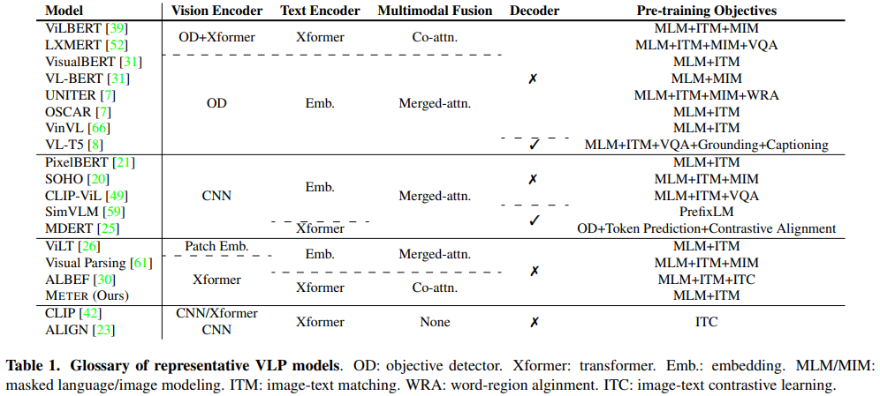
Representative VLP Models
Table source: Dou, Zi-Yi, et al. "An Empirical Study of Training End-to-End Vision-and-Language Transformers." arXiv preprint arXiv:2111.02387 (2021).

Slide 10
BLIP: Bootstrapping Language-Image Pre-training for Unified Vision-Language Understanding and Generation
Junnan Li Dongxu Li Caiming Xiong Steven Hoi
Salesforce Research
https://arxiv.org/pdf/2201.12086.pdf
https://github.com/salesforce/BLIP

Slide 11
Method

Slide 12
Motivation
Model perspective: most existing pre-trained models only excel in either understanding-based tasks or generation-based tasks
Data perspective: noisy image-text pairs collected from the web is a suboptimal source of supervision
Notes:
encoder-based models are less straightforward to directly transfer to text generation tasks (e.g. image captioning), whereas encoder-decoder models have not been successfully adopted for image-text retrieval tasks.

Slide 13
Motivation
Model perspective: most existing pre-trained models only excel in either understanding-based tasks or generation-based tasks
Data perspective: noisy image-text pairs collected from the web is a suboptimal source of supervision
BLIP is a new VLP framework.
BLIP transfers flexibly to both VL understanding and generation tasks.
BLIP effectively utilizes the noisy web data by bootstrapping the captions.
Notes:
encoder-based models are less straightforward to directly transfer to text generation tasks (e.g. image captioning), whereas encoder-decoder models have not been successfully adopted for image-text retrieval tasks.

Slide 14
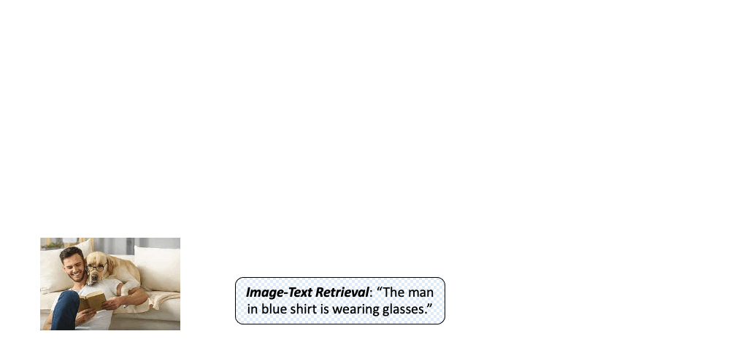
Pre-training Model and Objectives

Slide 15
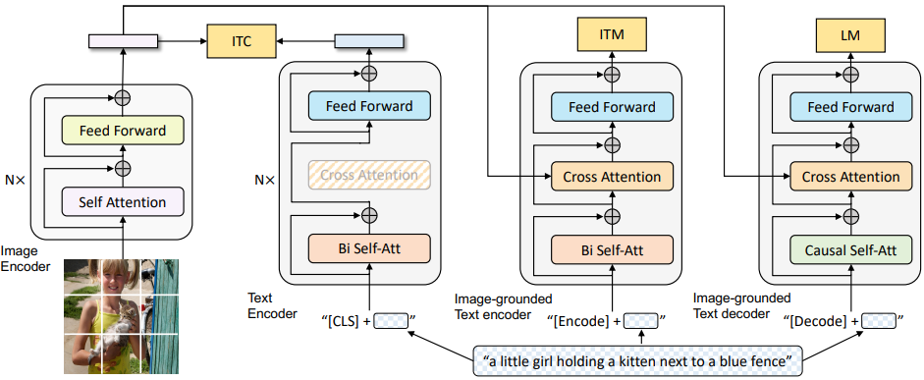
Pre-training Model and Objectives
Unimodal encoder: image-text contrastive (ITC) loss.
Image-grounded text encoder: image-text matching (ITM) loss.
Image-grounded text decoder: language modeling (LM) loss.
Same parameters have the same color.
Self-Att layers do not share parameters.
Notes:
and shares the same cross-attention layers and feed forward networks as the encoder.
Bi/causal self-att
ITM: hard negative mining strategy by Li et al. (2021a), where negatives pairs with higher contrastive similarity in a batch are more likely to be selected to compute the loss

Slide 16
Pre-training Model and Objectives
Unimodal encoder: image-text contrastive (ITC) loss.
Generate pseudo-targets using the momentum model (a moving-average version of the base model) as additional supervision during training.
Notes:
a momentum encoder is introduced to produce features
soft labels are created from the momentum encoder as training targets to account for the potential positives in the negative pairs.

Slide 17
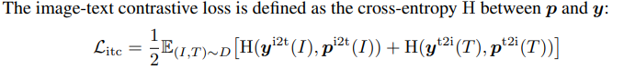
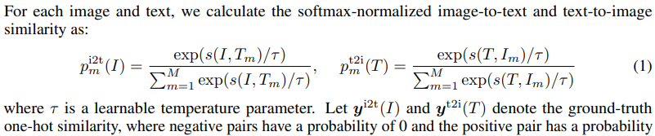
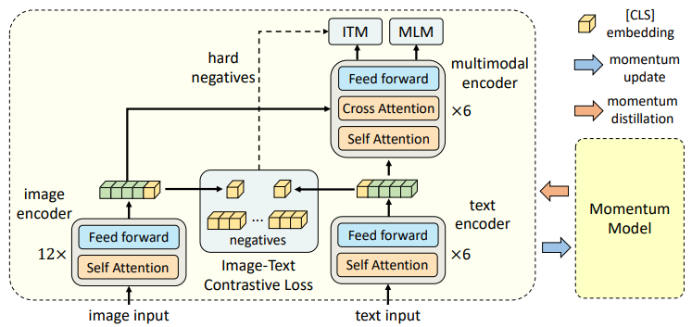
Pre-training Model and Objectives
Unimodal encoder: image-text contrastive (ITC) loss.
Li, Junnan, et al. "Align before fuse: Vision and language representation learning with momentum distillation." in NeurIPS 2021.

Slide 18
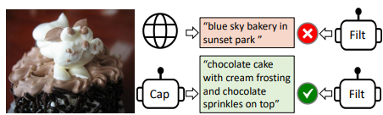
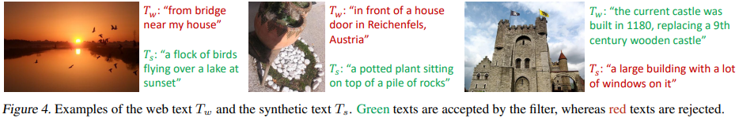
Bootstrapping method: Captioning and Filtering (CapFilt)
A dataset bootstrapping method to learn from noisy image-text pairs.
Captioner: produce synthetic captions given web images
Filter: remove noisy image-text pairs.

Slide 19
Bootstrapping method: Captioning and Filtering (CapFilt)
The captioner and filter are initialized from the same pre-trained model and finetuned individually on the COCO dataset.
Filter
Captioner
Notes:
Different from mostly existing KD methods which simply enforce the student to have the same class predictions as the teacher, our proposed CapFilt can be interpreted as a more effective way to perform KD in the context of VLP, where the captioner distills its knowledge through semantically-rich synthetic captions, and the filter distills its knowledge by removing noisy captions.

Slide 20
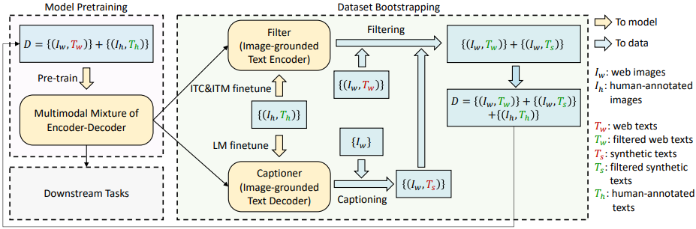
Bootstrapping method: Captioning and Filtering (CapFilt)
Pre-train a new model with the bootstrapped dataset (= the filtered image-text pairs + the human-annotated pairs)

Slide 21
Experiments

Slide 22
Pre-training Details
Data: 14M image: COCO + VG + CC + CC12M + SBU captions; 129M image: +LAION
Initialization: image: ViT pre-trained on ImageNet; text: BERTbase
Training: two 16-GPU nodes; 20 epochs using a batch size of 2880 (ViT-B) /2400 (ViT-L).
Image process: patches: 16×16; pre-train: random image crops of resolution 224×224; fine-tune: 384 × 384

Slide 23
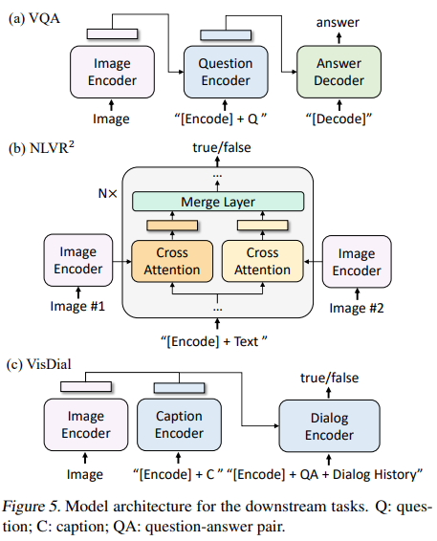
Downstream Tasks
Image Captioning & VQA: LM loss
generative
Image-Text Retrieval: ITC and ITM losses
Natural Language Visual Reasoning (NLVR^2)
whether a sentence describes a pair of images
Visual Dialog (VisDial): ITM loss
ranks a pool of answer candidates

Slide 24
Ablation Findings
CapFilt is effective and scalable.
Diversity is key for synthetic captions.
Sharing the parameters of all layers except for SA in pre-training, but not sharing the captioner and the filter in CapFilt.
A new model should be trained on the bootstrapped dataset.

Slide 25
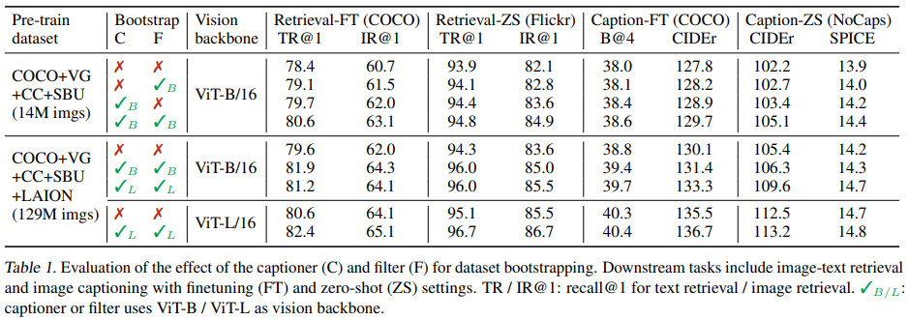
CapFilt is Effective and Scalable
Scalability: CapFilt can further boost performance with a larger dataset and a larger vision backbone

Slide 26
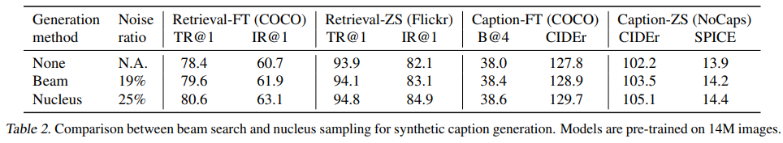
Diversity is Key for Synthetic Captions
Nucleus sampling performs better.
Nucleus sampling is more noisy (a higher noise ratio from the filter). It generates more diverse captions with new information.
Nucleus (top-p) sampling: each token is sampled from a set of tokens whose cumulative probability mass exceeds a threshold p (p = 0.9)
Beam search: generate captions with the highest probability

Slide 27
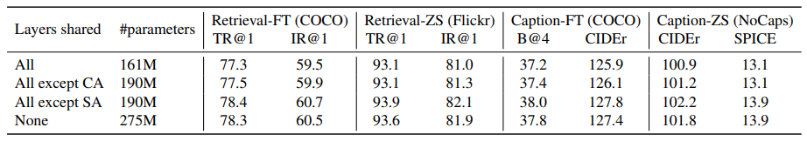
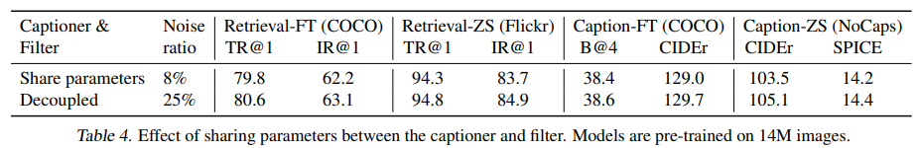
Parameter Sharing and Decoupling
Do not share the parameters of the self-attention layers (SA) in pre-training due to the conflict between the encoding task and the decoding task.
Sharing all layers except for SA: better performance and smaller model size.
Do not share the parameters of the captioner and the filter in CapFilt.

Slide 28
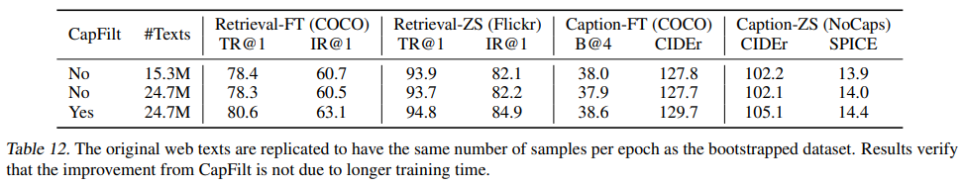
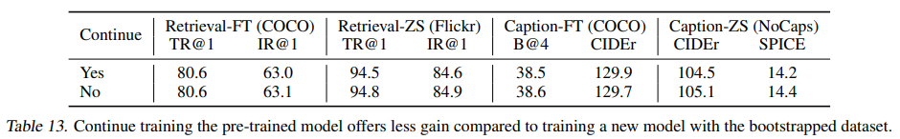
Training Strategy
Improvement with CapFilt is not due to longer training.
A new model should be trained on the bootstrapped dataset.

Slide 29
Comparison with State-of-the-arts

Slide 30
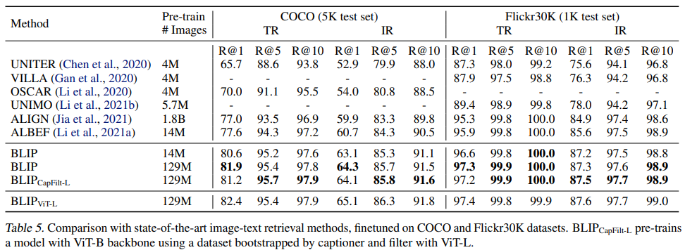
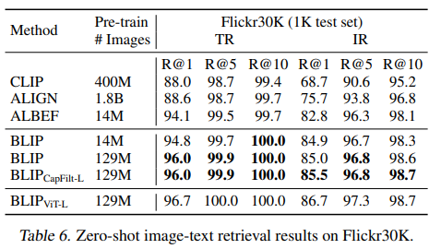
Image-Text Retrieval
Notes:
We finetune the pre-trained model using ITC and ITM losses. To enable faster inference speed, we follow Li et al. (2021a) and first select k candidates based on the image-text feature similarity, and then rerank the selected candidates based on their pairwise ITM score

Slide 31
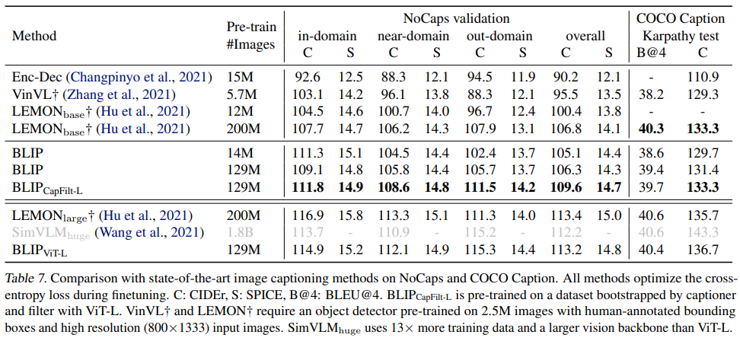
Image Captioning

Slide 32
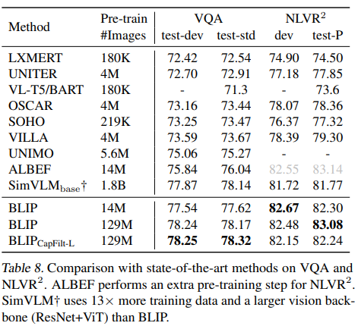
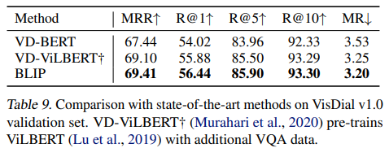
VQA, NLVR^2, and VisDial
Performance on NLVR^2 does not benefit much from additional web images, possibly due to the domain gap between web data and downstream data.

Slide 33
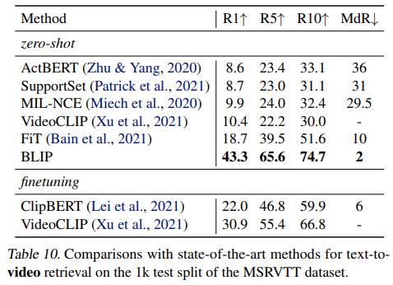
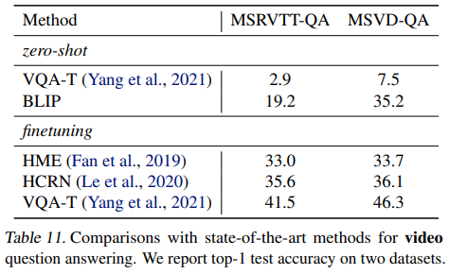
Zero-shot Transfer to Video-Language Tasks

Slide 34
Insights and Limitations
BLIP effectively utilizes the noisy web data by bootstrapping the captions, and demonstrates the advantage of synthetic captions in large-scale vision-language pre-training
BLIP transfers flexibly to both VL understanding and generation tasks.
The multi-stage pre-training pipeline is slow.
Do not compare different unified architectures for understanding-based and generation-based VLP.
Unified VLP
VL-T5
SimVLM
BLIP
Notes:
Unified VLP would be slow for image-text retrieval task.
VL-T5 and SimVLM is not suitable for image-text retrieval task.
BLIP is effective for image-text retrieval task.

Slide 35
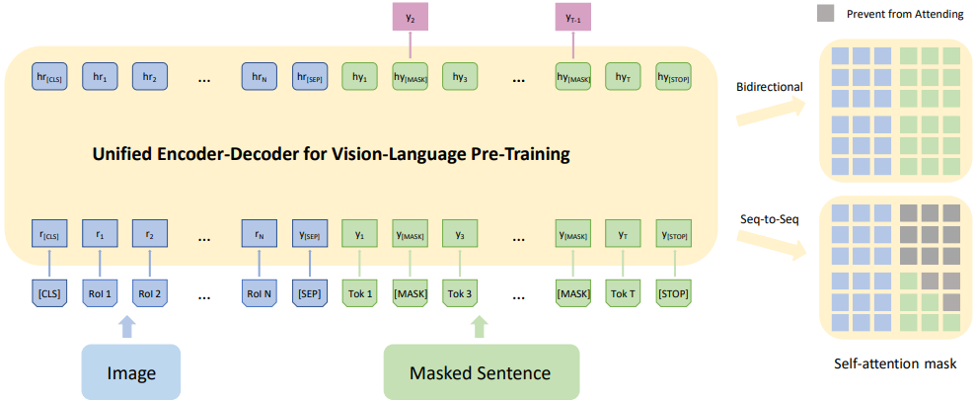
Unified Understanding & Generation VLP
Unified VLP: Unified Vision-Language Pre-Training for Image Captioning and VQA
Zhou, Luowei, et al. "Unified vision-language pre-training for image captioning and vqa." in AAAI 2020.
Notes:
Unified-modal learning: Both image collections, text corpus, and image-text pairs can be effectively utilized for pre-training; either unimodal inputs or multimodal inputs (UNIMO, UFO)

Slide 36
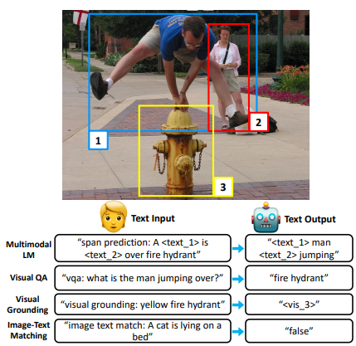
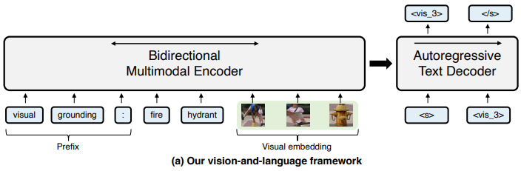
Unified Understanding & Generation VLP
VL-T5: Unifying Vision-and-Language Tasks via Text Generation
Cho, Jaemin, et al. "Unifying vision-and-language tasks via text generation." International Conference on Machine Learning. PMLR, 2021.
Notes:
Unified-modal learning: Both image collections, text corpus, and image-text pairs can be effectively utilized for pre-training; either unimodal inputs or multimodal inputs (UNIMO, UFO)

Slide 37
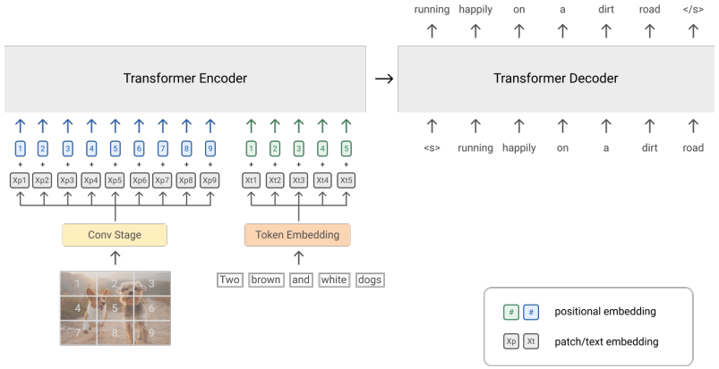
Unified Understanding & Generation VLP
SimVLM: Simple Visual Language Model Pretraining with Weak Supervision
Wang, Zirui, et al. "Simvlm: Simple visual language model pretraining with weak supervision." arXiv preprint arXiv:2108.10904 (2021).
Notes:
Unified-modal learning: Both image collections, text corpus, and image-text pairs can be effectively utilized for pre-training; either unimodal inputs or multimodal inputs (UNIMO, UFO)

Slide 38
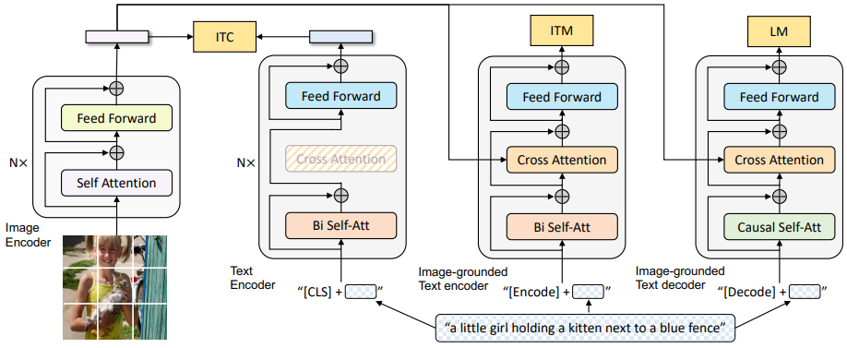
Unified Understanding & Generation VLP
BLIP: Bootstrapping Language-Image Pre-training for Unified Vision-Language Understanding and Generation
Li, Junnan, et al. "BLIP: Bootstrapping Language-Image Pre-training for Unified Vision-Language Understanding and Generation." arXiv preprint arXiv:2201.12086 (2022).
Notes:
Unified-modal learning: Both image collections, text corpus, and image-text pairs can be effectively utilized for pre-training; either unimodal inputs or multimodal inputs (UNIMO, UFO)

Slide 39
Future Directions
End-to-end pre-training without complex pre-processing.
Unified architectures, tasks and modalities.

Slide 40
Thank you.

